Slide 1
Uno - Software Store
Instructor - Jia Zhang
Team 1 Yuejun Ma
Litong Xiao
Haoran Li
Sriharsha Bandaru
[18653] Software Architecture and Design, Spring 2019

Slide 2
Roadmap
Introduction
Motivation
Related work
System design
System implementation
Demo
Experiments/analysis
Conclusions and future work
Notes:
This is the structure of our presentation, we will go through each topic.

Slide 3
Introduction - Uno
Uno is an online software sales platform that allows software developers and customers to trade software online
Registered software developers can post products on Uno and set prices. Customers can purchase softwares already on the site
In addition, the website provides a social network for customers and developers
Notes:
First, a brief introduction of the project. Our software is named Uno. It is an online software sales platform that allows software developers and customers to trade software online. People can either registered as a developer or a customer. The registered developers can….. The registered customers can…… Besides this, our website also provides social network for registered users, such as search, comment, question network. Will give more details later.

Slide 4
Motivation - Connecting developers and users
High number of software developers in the world (we may be one of them) building software, and also higher number of people who use these software
Most of these useful software difficult to find for users and developers have difficulties in reaching out to users
Users want to be able to find all the softwares they need on a single platform and buy them legally and conveniently
Built Uno which is more focus on software trading
Notes:
Like I said, Uno is a platform for software trading. Our goal is connecting software developers and users. There are a lot of useful software in the world. And also many people are willing to buy and use those softwares. Sometimes, it is difficult for both the customers and the developers to get in touch. So here is the Uno, which offers an convenient and legal way for software trading. Customers can purchase whatever softwares available here on our website.

Slide 5
Related Work
Platforms like amazon.com and ebay.com provide a way to publish products and purchase them
These platforms are much more generic
Our platform focuses specifically on software products
Notes:
To actually work on this project. We looked into some other eCommence website, like Amazon and Ebay. We learned some feature from them. As a matter of fact, it’s an Amazon-like online store, but only for software trading.

Slide 6
System Design

Slide 7
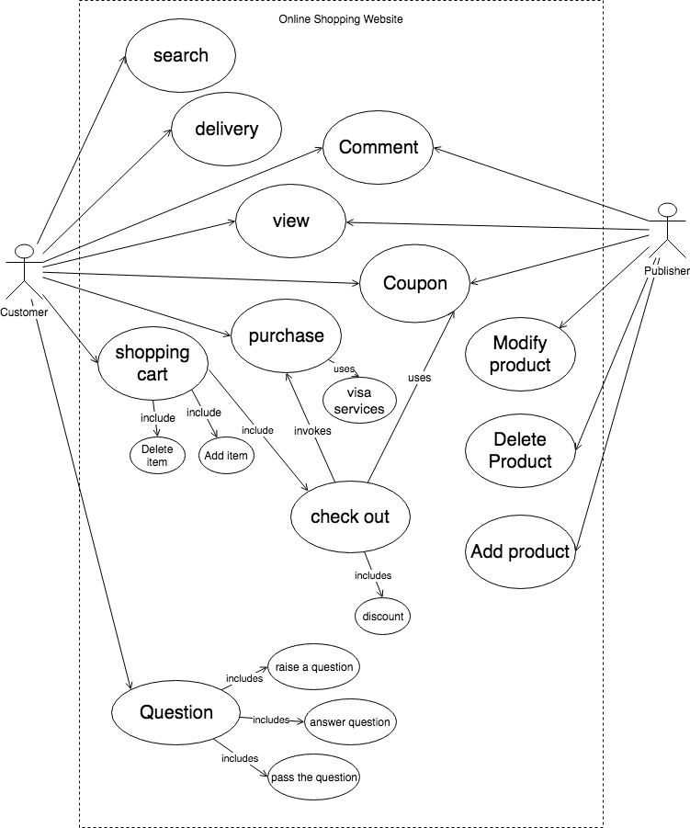
Use cases
Search
Delivery
Comment
Coupon
Shopping cart
Purchase
Post question
Comment
Search
Manage coupons
Manage products
Notes:
This is the use cases diagram. The customer can search through our website for the products he’s looking for. He can also choose the prefered delivery option. He can add comments to the products listed. He can apply coupons he got from the publisher/developer. He can purchase
Two roles, customer and publish/developer

Slide 8
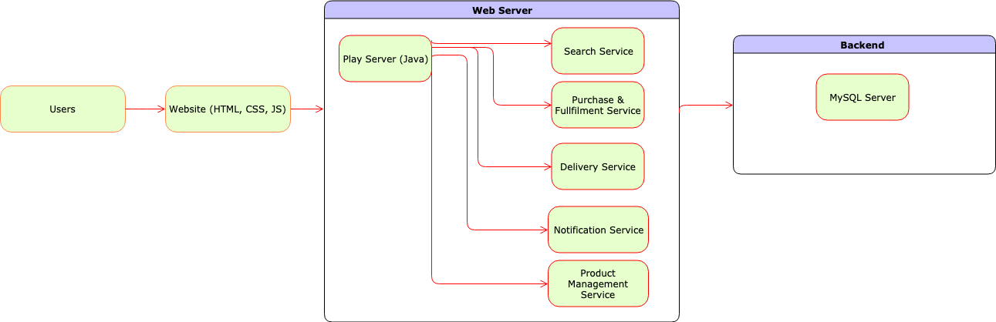
Architecture view - Monolithic
Notes:
The user can register and login to our website. The front end is for the interactions of the users and our website. We used HTML, CSS, and JS for the front end part. The main structure of our website is the web server. We use the play framework here for the server. The server offers several services, like search, purchase, delivery, notification, and product management. We save our data in the backend using MySQL database.
Trigger the backend

Slide 9
System Implementation

Slide 10
User Interface
- Customer will be using the user interface to perform actions such as search, purchase, etc.
- Design Pattern: Facade Pattern and Command Pattern
- Facade pattern to hide the internal details of the functions from the user
- Command pattern for internally performing the right function (search, purchase, etc.) for the user

Slide 11
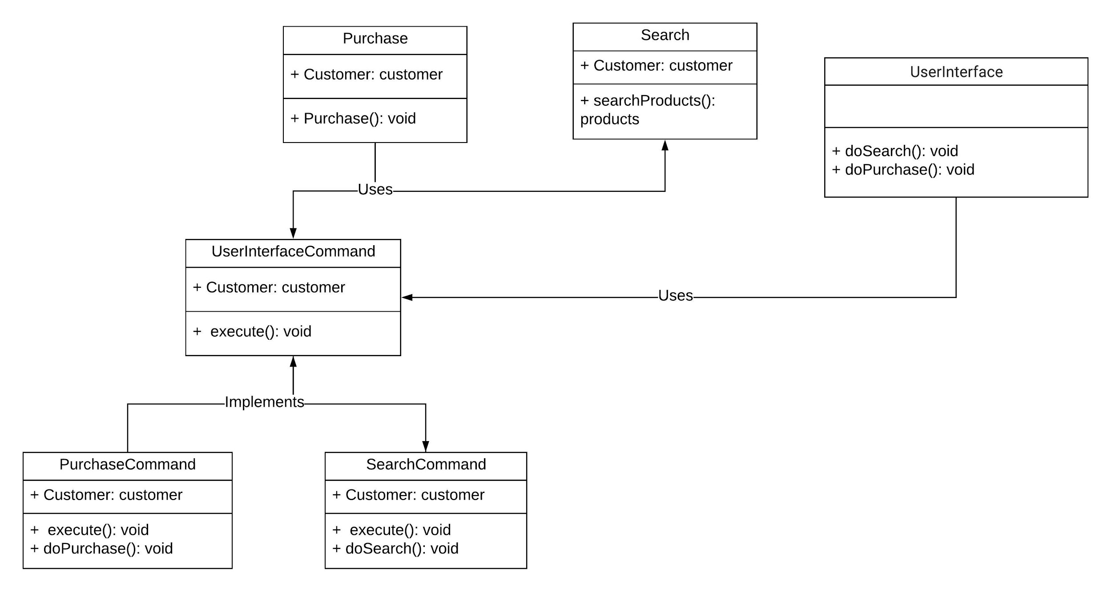
Implementation

Slide 12
Purchase and Discount System
- Purchase and Discount systems helps the customers to view the total price and discounts applied on the products
- Design pattern : Strategy and Decorator Pattern
- Strategy pattern used for choosing the proper discount based on the total number of products
- Decorator pattern used for applying the discount on the the purchase fee during checkout

Slide 13
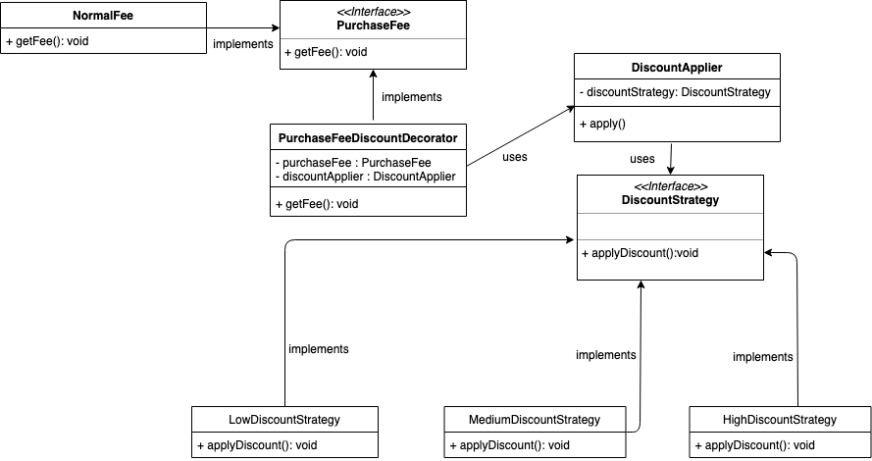
Implementation

Slide 14
Message system
- Developers can send messages to all the customer that purchased their product before
- Customer can view all the messages they receive.
- Design pattern : Mediator Pattern
- Each customer has a message receiver center, and developer has a message send center. And all operations about message are done in MessageController.

Slide 15
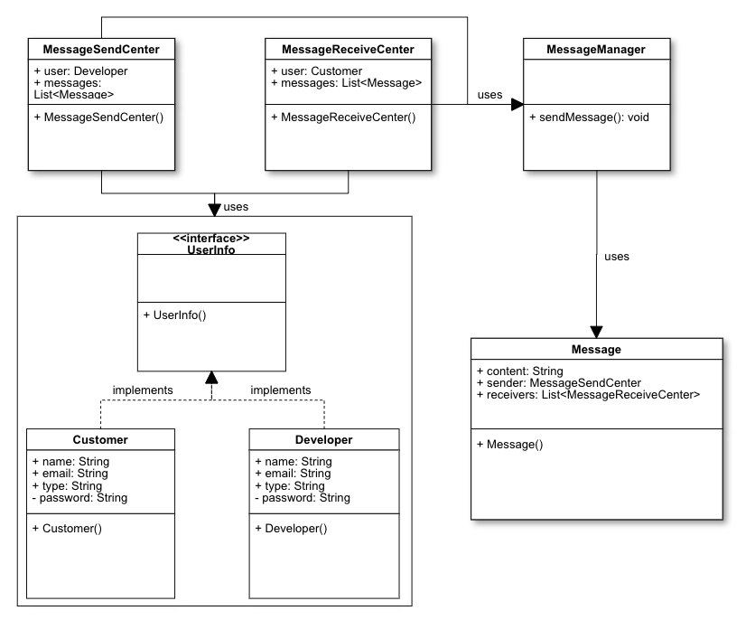
Implementation

Slide 16
Comment system
- Customers can make comment on a product.
- All other customers can view comments of any product.
- Design Pattern : Mediator Pattern
- Each product has a special class to manage all comments of this product.
- Comment Manager will handle all operations about comments

Slide 17
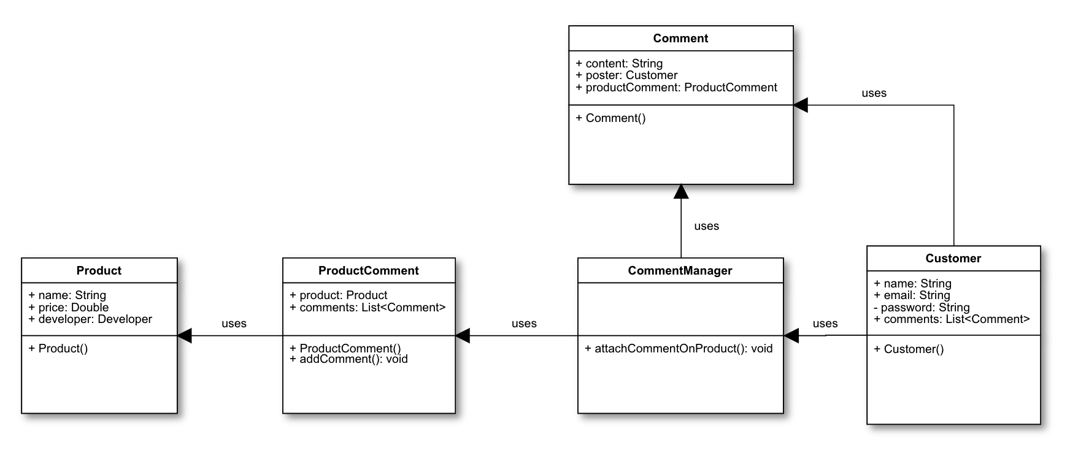
Implementation

Slide 18
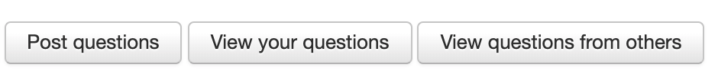
Question system
- Customers can post question about a product
- Customers can view all questions from others, they can either answer the question or pass the question to other customer who also purchased the product
- Design pattern: Chain of Responsibility Pattern + Mediator Pattern
- Once the question is answered, the question won’t be passed to the next customer and question poster can see the answer in his own question pool

Slide 19
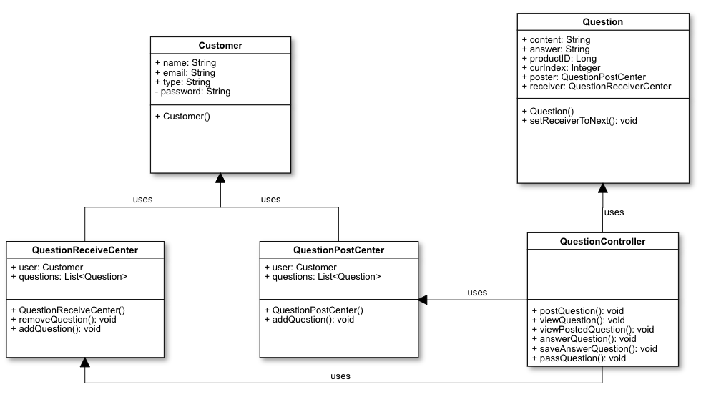
Implementation

Slide 20
Inventory system
- Each customer has an inventory to monitor the lifecycle of products they ordered
- Design Pattern : State Pattern
- Each product order has a status field that can be set by a status object
- Three status: ordered - paid - delivered
Once the product is added into order from cart, its status becomes “ordered”
Once customer pay for the order, its status becomes “paid”
The delivered status need information about logistics, currently not support

Slide 21
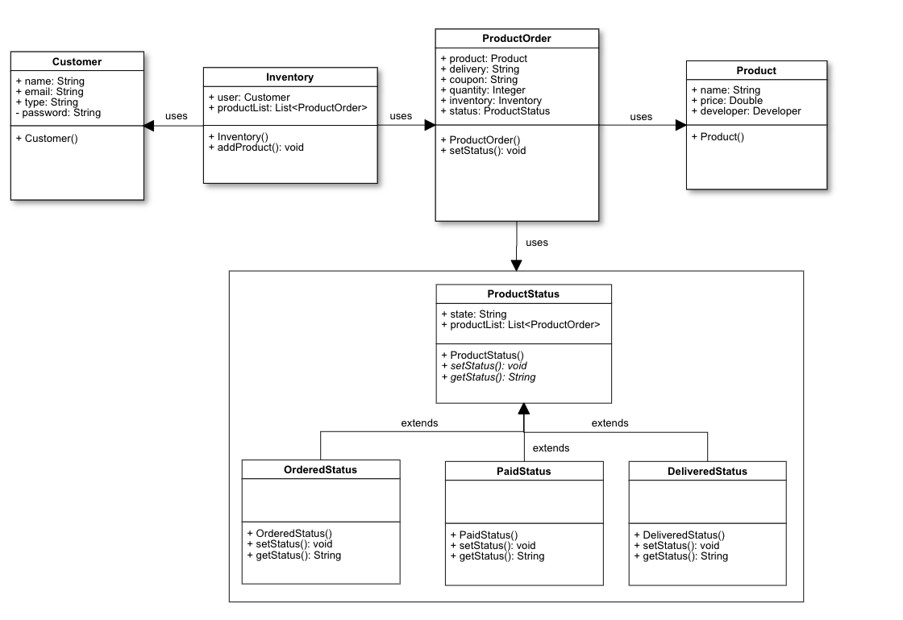
Implementation

Slide 22
Coupon system
- Developers can send coupon to all the customer that purchased their product before; they can choose the coupon discount between 20%/40%/60%
- Customers only can use the coupon when they buy the same product again (there is no option for coupon if customer don’t have the coupon); In addition, they can view all the coupon they have (including discount and product).
- Design Pattern : Observer Pattern + Decorator Pattern
- Use Notifyall() function to send the coupons to the certain customers.
- Use the same discount decorator to calculate price
- Future work: Delete the coupon after it used
Notes:
As for the coupon system, developers can …. And Customer can… In this system, I use Observer pattern and Decorator Pattern. Observer pattern is used for send out the coupons from developer. And Decorator Pattern is used for calculate the total price. It use the same discount decorator in discount system. There is some problems right now. If the customer have the coupon, then you can use it forever. So I may fix it by Friday.

Slide 23
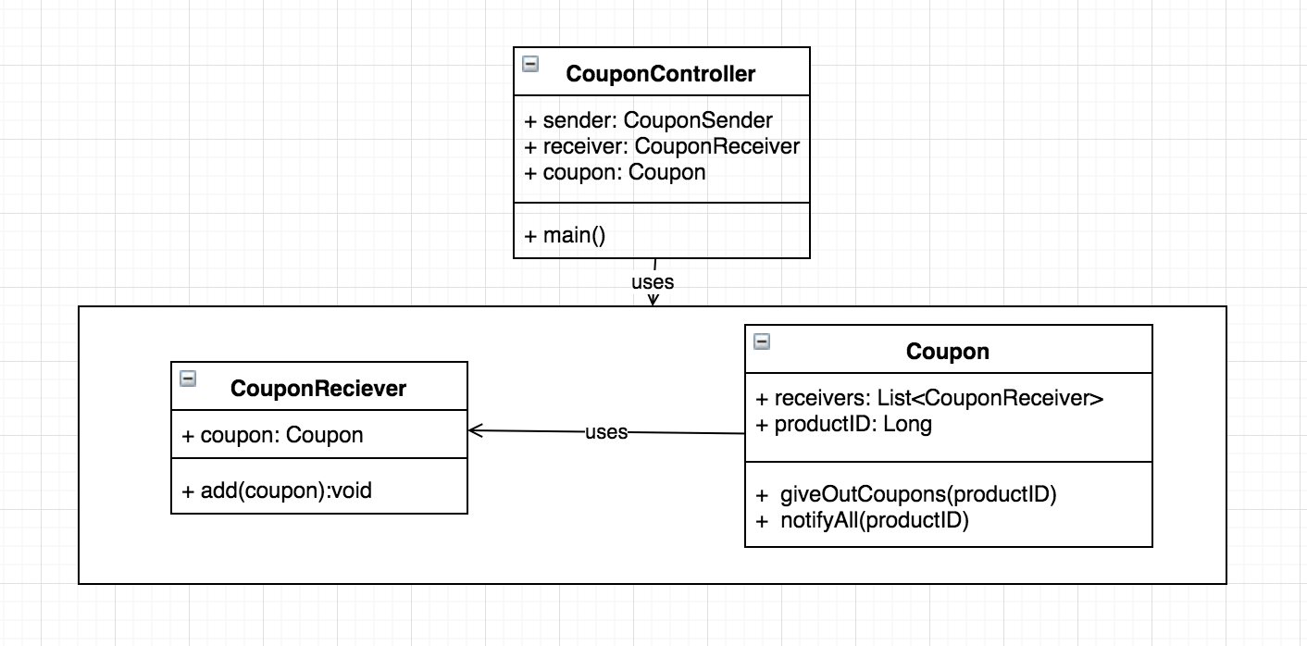
Implementation - Observer Pattern
Notes:
notifyAll(CouponReciever)
giveOutCoupons(CouponReiciever)

Slide 24
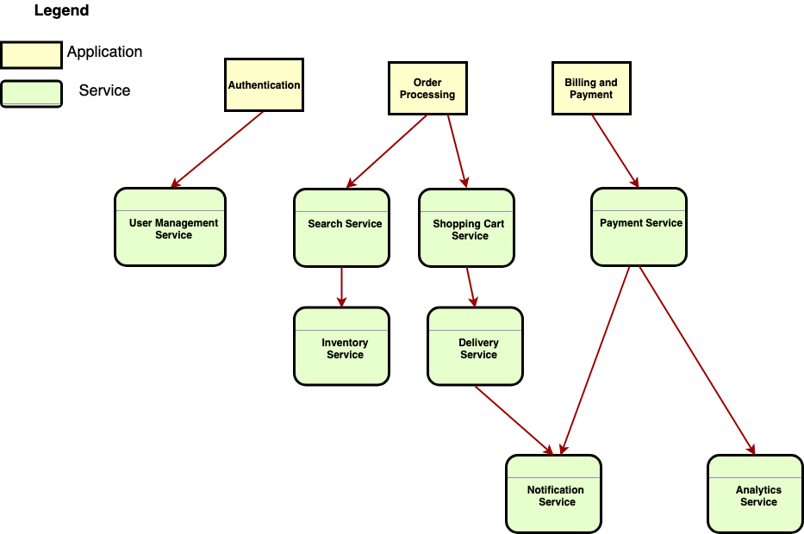
Service Oriented Architecture

Slide 25
Environment
Play framework (Java)
IntelliJ IDE for development.
Source Code: https://github.com/cmusv-sc/18653-Spring2019-Team1
Library dependencies:
Java 1.8
SBT (scala)
How to run:
Import project into IntelliJ
Run the application using IDE or use “sbt run” from terminal

Slide 26

Demo

Slide 27
Conclusion and future work
Used design patterns and architecture principles for the application development
Multiple instances of the web server and database for increased availability of the server
Improved security for authentication system
Adopt Devops using Docker containers for a faster test and deploy
Notes:
Multiple different design patterns and architecture principles for the development

Slide 28
Thank you.

